Slide 1


Perfecting Your Pitch: From Idea to Impactful Presentation

Slide 2
Workshop Objective
The "Perfecting Your Pitch" workshop aims to equip the participants with the essential skills and knowledge required to craft and deliver compelling pitches for their innovative solutions.

Slide 3
Mock Pitching
A significant portion of the workshop is dedicated to practice, with participants presenting their pitches and receiving constructive feedback from the NEX PH team.

Slide 4
Understanding your Audience
Notes:
This section will delve into the critical importance of knowing your audience and how to tailor your pitch to meet their specific interests and needs.
Discussing the different stakeholders: investors, partners, customers.
Tailoring your pitch to the needs and interests of your audience.
The importance of empathy and storytelling in connecting with your audience.

Slide 5
Audience
Investors
Customers
Partners

Slide 6

Investors
Investors are typically driven by financial returns. They want to know about the profitability and scalability of your idea, market opportunities, potential risks, and your strategies for generating revenue.

Slide 7

Customers
Your customers are the end-users of your product or service. They are primarily concerned with how your solution addresses their pain points, improves their lives, or fulfills their needs.

Slide 8

Partners
Partners, such as other businesses or organizations, look for collaboration and synergy. They are interested in how your solution can align with their goals, complement their operations, or create mutual benefits.

Slide 9
Tailoring your Pitch
To create an effective pitch, you should customize your message for each stakeholder group.
This process includes:
Customized content
Addressing pain points
Appropriate language

Slide 10
Tailoring your Pitch
Highlight aspects of your startup that are most relevant to each stakeholder.
Customized Content
Clearly articulate how your solution solves the unique challenges or pain points of the stakeholder.
Addressing Pain Points
Appropriate Language
Speak in a language that resonates with your audience.

Slide 11
Investors
What to highlight in your pitch?
Financials
Market potential
Credibility of the team
Plans and projections

Slide 12
Customers
What to highlight in your pitch?
Features of your product
How the product is solving their current problem
Credibility of the team

Slide 13
Partners
What to highlight in your pitch?
Synergy
Market potential
Technical aspects of the partnership

Slide 14
Importance of Empathy and Storytelling
Empathy
Put yourself in your audience's shoes.
Understand their concerns, goals, and motivations.

Slide 15
Importance of Empathy and Storytelling
Storytelling
Stories have the remarkable ability to captivate an audience.
They make information relatable, memorable, and emotionally engaging.

Slide 16
Creating Emotional Connection
The most effective pitches extend beyond facts and figures; they create an emotional connection.

Slide 17
Creating Emotional Connection
Reflect on the following questions on how you can create a pitch that establishes emotional connection with your audience:
How do you currently adapt your pitch for different stakeholders?
Can you provide examples of when you have successfully engaged your audience emotionally through storytelling in a pitch?
What challenges have you faced when trying to tailor your pitch to specific audiences, and how did you overcome them?
In what ways do you incorporate empathy into your pitch preparation? Do you have specific strategies that have worked effectively?

Slide 18
Structuring your Pitch
Notes:
We will delve into the classic pitch structure, which includes essential elements such as defining the problem, presenting the solution, analyzing the market, introducing the team, sharing traction, and making an ask (if applicable). Furthermore, we will emphasize an analysis of the judging criteria and how it can be effectively translated into a compelling startup pitch in this section.
The classic pitch structure: Problem, Solution, Market, Team, Traction, Ask (if applicable).
Crafting a compelling hook or opening to grab attention.
The art of clear and concise communication: avoiding jargon and buzzwords.
How to translate the judging criteria into a compelling pitch

Slide 19



Classic Pitch Structure
What is the problem you are trying to address?
Is the problem you are trying to solve the root cause of that problem? (e.g. traffic congestion)
What is your solution to solve the problem? How does it work? Why is it better compared to other alternatives?
Who are your customers? How big is your market?
Notes:
- traffic congestion is not the problem, it is the result of various problems and inadequacies such as overpopulation, lack of public transportation, high vehicle ownership, inadequate traffic management, behavior and driving habits, and so on.

Slide 20



Classic Pitch Structure
Who are the people behind the team? Why are you the best team to implement the solution?
Rather than focus on your titles (academic designation, 3Hs), highlight your skills and qualifications helpful to implement the solution.
How has the startup progressed? (e.g. revenue generated, user growth, etc.)
What are you looking for and how their involvement can contribute to your startup’s success?
Differs based on your audience (customers = sales, investors = funds, partners = collaboration, etc.)

Slide 21
Designing your “Hook”
A brief, attention-grabbing introduction or opening statement that is designed to capture the audience's interest and make them want to learn more about your startup.
A compelling and memorable way to start your pitch and create curiosity among potential investors, partners, or stakeholders.
Can make your pitch more engaging and memorable, increasing your chances of making a positive impression.

Slide 22
Hook Designs
Start with a story. Engage your audience with a captivating and relevant story that illustrates the problem you are solving or the journey that led to your startup.
Use a Bold Statement or Question. Begin with a thought-provoking statement or a compelling question that challenges conventional wisdom or sparks curiosity.
Highlight the Impact. Show the potential positive impact or transformation your startup can bring to individuals, businesses, or society as a whole.

Slide 23
Hook Designs
Showcase Social Proof. If you have relevant statistics, endorsements, or success stories, use them in your hook to demonstrate that your startup is addressing a real need and gaining recognition.
Create a Visual Image. Use descriptive language that paints a vivid picture in the minds of your audience. Help them visualize the problem, your solution, or the future you're striving to create.

Slide 24
The Art of Clear and Concise Communication
Refers to specialized terminology or language that is used within a particular industry, profession, or group. It is a technical language used to enhance precise communication among experts in a field but may be confusing for those unfamiliar with the subject matter.
JARGON
Are trendy or fashionable words or phrases that gain popularity in the broader culture, often in the realms of business, marketing, or technology. They are often used to make something sound more exciting, important, or innovative than it may actually be.
BUZZWORD

Slide 25
Yay or nay?
EnergiX's solution revolves around advanced grid integration, using cutting-edge technology like predictive analytics and distributed energy resources (DERs) to enhance grid stability and minimize peak demand. Our microgrids and blockchain-based energy transactions provide unmatched grid flexibility and decentralization, ushering in a more sustainable and efficient energy ecosystem.

Slide 26
Nay, nay, nay!
EnergiX's solution revolves around advanced grid integration, using cutting-edge technology like predictive analytics and distributed energy resources (DERs) to enhance grid stability and minimize peak demand. Our microgrids and blockchain-based energy transactions provide unmatched grid flexibility and decentralization, ushering in a more sustainable and efficient energy ecosystem.
At EnergiX, our solution is all about making the energy grid smarter. We use the latest technology to predict energy needs and incorporate clean energy sources like solar and wind to keep the grid stable, even during peak times. We have also made it easier for people to buy and sell extra energy, making the whole system more sustainable and efficient for everyone.

Slide 27
Yay or nay?
At EnergiX, our solution is focused on using the newest technology to enhance energy. We use smart technology and improved energy sources to make the grid more intelligent and flexible. With secure technology and advanced energy storage, we are working towards a future that's not only better for the environment but also stronger and more cost-effective.
At EnergiX, our solution is all about embracing the latest energy innovations. We use AI-powered predictive analytics and advanced energy resources to make the grid smarter and more adaptable. With blockchain technology and cutting-edge energy storage materials, we are driving a future that is not just more eco-friendly but also more resilient and efficient.

Slide 28
Translating judging criteria into your pitch …
SUSTAINABILITY
INNOVATION
BUSINESS MODEL
IMPACT
Evaluate the solution's long-term viability, assessing its promotion of environmental, economic, and social sustainability by minimizing negative impacts and optimizing resource utilization.
Evaluates the originality and inventiveness of the participant's solution, emphasizing creative problem-solving and the introduction of fresh and inventive ideas that make the solution stand out.
Evaluates the participant's concept for feasibility and scalability, focusing on its potential as a sustainable business venture by examining revenue streams, cost structures, and growth strategies, gauging their ability to translate innovation into success.
Measures the potential positive change brought about by the solution, evaluating its effectiveness in addressing real-world challenges and enhancing lives, while considering the depth and articulation of its impact.
PROTOTYPE
PITCH PRESENTATION
TEAM
Assesses the team's ability to present a tangible prototype embodying their concept, demonstrating its viability and potential, with judges evaluating both the quality and functionality of the prototype.
Evaluates the participant's effective communication of the solution, with judges assessing clarity, organization, engagement, and delivery, as a compelling presentation enhances the solution's appeal and impacts the overall evaluation.
Assesses the collaborative dynamics within each team, evaluating how effectively individual skills and expertise synergize to contribute to a well-rounded and coordinated solution.

Slide 29
Sustainability
Evaluate the solution's long-term viability, assessing its promotion of environmental, economic, and social sustainability by minimizing negative impacts and optimizing resource utilization.
Outline eco-friendly practices embedded in your operations, production, or service delivery.
Feature the use of sustainable or recyclable materials in your product or service (if applicable).
Showcase how the startup optimizes resource utilization to minimize waste and environmental impacts.
Explain any practices related to circular economy, such as product recycling, refurbishing, or reusability.

Slide 30
Innovation
Evaluates the originality and inventiveness of the participant's solution, emphasizing creative problem-solving and the introduction of fresh and inventive ideas that make the solution stand out.
Highlight specific features or aspects of your solution that are innovative and set it apart from existing solutions and how these features creatively address the problem at hand.
If applicable, discuss any proprietary technology or intellectual property that underpins your solution, emphasizing its uniqueness and inventiveness.
Describe the novel approaches or methodologies your team has employed to tackle the problem and how these approaches are fresh and inventive within the context of the industry.
If you are incorporating cutting-edge technologies, explain how their integration contributes to the overall innovation of your solution.

Slide 31
Business Model
Evaluates the participant's concept for feasibility and scalability, focusing on its potential as a sustainable business venture by examining revenue streams, cost structures, and growth strategies, gauging their ability to translate innovation into success.
Clearly outline your primary and potential secondary revenue streams and details on how your startup plans to generate income.
Outline your pricing strategy, emphasizing its alignment with market demands, and showcase any competitive pricing advantages or distinctive pricing models.
Share your approach for obtaining and retaining customers, encompassing strategies in marketing, sales, and customer relationship management.
Provide an overview of your growth strategies, detailing expansion plans, partnerships, or additional initiatives that contribute to the overall growth of your startup.

Slide 32
Impact
Measures the potential positive change brought about by the solution, evaluating its effectiveness in addressing real-world challenges and enhancing lives, while considering the depth and articulation of its impact.
Illustrate how your startup enhances the lives of individuals, communities, or society at large. Use testimonials, case studies, or stories to bring this impact to life.
Highlight how your startup's impact aligns with relevant Sustainable Development Goals, emphasizing its contribution to broader global objectives.
Emphasize both environmental and social impacts, showcasing a holistic approach to positive change.
Environmental impact includes usage of renewable energy sources and carbon emission reduction.
Social impact includes job creation, community engagement initiatives, and inclusive practices.

Slide 33
Prototype
Assesses the team's ability to present a tangible prototype embodying their concept, demonstrating its viability and potential, with judges evaluating both the quality and functionality of the prototype.
Demonstrate the functional capabilities of your prototype, allowing judges to witness how it operates and fulfills its intended purpose effectively.
Discuss any iterations or improvements made to the prototype based on testing and feedback, demonstrating a commitment to continuous improvement.
Use visuals, diagrams, or animations to enhance the judges' understanding of your prototype's design and functionality, providing a comprehensive overview.
Share insights from testing and validation processes, emphasizing how these steps contribute to the overall refinement and reliability of your prototype.

Slide 34
Pitch Presentation
Evaluates the participant's effective communication of the solution, with judges assessing clarity, organization, engagement, and delivery, as a compelling presentation enhances the solution's appeal and impacts the overall evaluation.
Clearly articulate your solution, ensuring that judges can easily grasp the core concept, value proposition, and key features.
Structure your presentation in a logical and organized manner, guiding judges through a cohesive narrative that highlights the problem, solution, and impact.
Implement engagement strategies, such as visuals, anecdotes, or interactive elements, to capture the judges' attention and maintain their interest throughout the presentation.
Pay attention to your delivery, including tone, pace, and enthusiasm, to convey confidence and passion about your solution.

Slide 35
Team Composition
Assesses the collaborative dynamics within each team, evaluating how effectively individual skills and expertise synergize to contribute to a well-rounded and coordinated solution.
Showcase how the individual skills and expertise of each team member complement one another, creating a synergy that enhances the overall capabilities of the team.
Discuss how tasks are delegated within the team, showcasing a strategic approach that leverages each team member's strengths and expertise for optimal outcomes.
Acknowledge and recognize individual contributions within the team, demonstrating an appreciation for the unique strengths each member brings to the collaborative effort.

Slide 36
Water Break
5 Minutes

Slide 37


Slide 38
Storytelling Techniques
Notes:
The power of storytelling in pitches will be emphasized, including the crafting of a narrative that connects with the audience on an emotional level.
The power of storytelling in pitches.
Crafting a narrative that engages your audience emotionally.
The hero's journey: How your idea can be the hero in solving a problem.

Slide 39
Why storytelling is a game-changer?
Emotional Connection: Stories create deep emotional bonds, making your startup's journey and vision unforgettable.
Authenticity: Storytelling showcases your startup's character, values, and genuine passion, attracting investors.
Standing Out: Differentiate from competitors by highlighting your unique offering, team, and problem-solving prowess through storytelling.

Slide 40
Tips for on how to integrate storytelling into pitch
Tip 1: Craft a Captivating Opening
Begin with a captivating story or a thought-provoking question. For instance, share a personal anecdote about a problem your startup solves to grab your audience's attention.
Example: Picture a world where clean and sustainable energy is accessible to everyone. It's not a dream; it's the mission that drives our startup. I want to begin by sharing a remarkable moment when our technology harnessed the power of the sun to light up a remote village that had never seen electricity before.

Slide 41
Tips for on how to integrate storytelling into pitch
Tip 2: Create a Narrative Arc
Craft your pitch like a compelling story with a clear beginning (the problem), middle (how you tackled challenges and achieved success), and end (the impact).
For example, outline the obstacles you faced, victories you celebrated, and key takeaways, creating a vivid narrative of your startup's journey.

Slide 42
Tips for on how to integrate storytelling into pitch
Tip 3: Develop Relatable Characters
Create characters your audience can connect with, sharing their challenges and how your solution benefits them.
Example: Meet Sarah, a homeowner who's tired of high energy bills and worries about the environmental impact of traditional energy sources. She represents countless individuals looking for sustainable alternatives. Our solution not only reduces her costs but also fulfills her desire to live a greener lifestyle.

Slide 43
Tips for on how to integrate storytelling into pitch
Tip 4: Utilize Visuals
Enhance your storytelling with impactful visuals. Utilize infographics, product demos, and striking images to reinforce your points. For instance, showcase a graph illustrating your growth or a product demo to showcase its unique features.

Slide 44
Tips for on how to integrate storytelling into pitch
Tip 5: Incorporate Emotional Appeal
Evoke emotions like joy, fear, or hope to create a deeper connection with your audience.
Example: Imagine the joy of having access to clean and affordable energy. Our innovation promises to bring that joy to countless homes and businesses.

Slide 45
Tips for on how to integrate storytelling into pitch
Tip 6: End With a Memorable Takeaway
End with a clear and impactful message that encapsulates your pitch and encourages further engagement.
Example: With our solution, you're not just buying power; you're investing in a sustainable future. Be a catalyst for change and make a difference today.

Slide 46
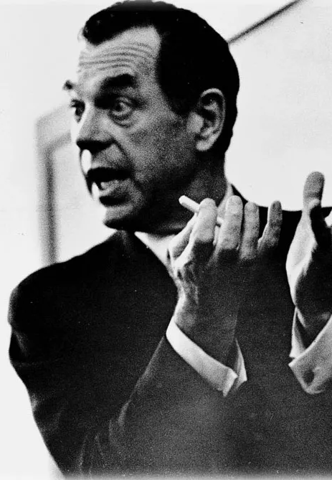
Hero’s Journey
The Hero’s Journey is the same exact tale every culture tells – just with different characters. Though the journey’s process can be in various manners, all of them have a few things in common – the call to adventure, a mentor, challenges, victory and the return.
- Joseph Campbell

Slide 47
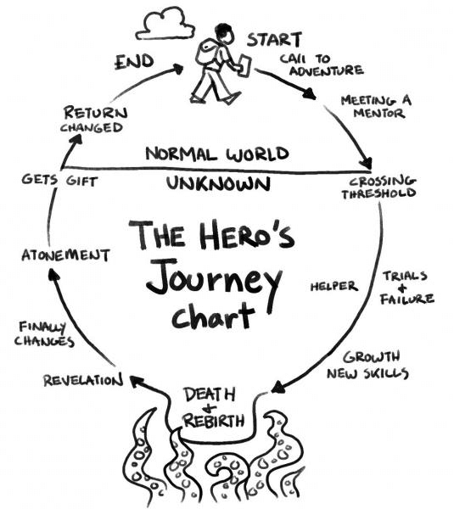
The Problem
The Solution
The Reward
Notes:
The hero starts out as an ordinary person. He or she then gets a ‘call to adventure’—sometimes by choice or by circumstance. As the hero leaves the comfort of their home and family to begin the journey, he or she faces life-threatening challenges along the way. The hero’s situation looks bleak and it further escalates to the Hero’s defeat. Then, just when all hope seems lost, the hero finds some inner strength to win despite the odds.
Good prevails over evil. The hero then returns to his or her ordinary life, but with a new addition – wisdom. This wisdom is then communicated to the rest of society for everyone’s benefit. If you noticed, all the tales of heroes have three things in common – the problem, the solution and the reward. You’ll notice that these three elements are always or mostly used in every hero tale and it never fails to attract the audience. Leverage on this three step approach to help make your pitch much more engaging which will empower your audience in return.

Slide 48



Hero’s Journey
The Problem
This element of your presentation addresses the critical issue at hand, such as the rapid depletion of traditional energy sources, rising energy costs, and environmental damage, making it clear why this issue matters.
The Solution
In your presentation, this part outlines actionable steps like adopting solar energy to combat the problem, providing the audience with a clear path to address the issue.
The Reward
This final aspect conveys the key message, in this case, the benefits of embracing solar energy, including lower costs, reduced emissions, and a more sustainable energy future, ensuring your presentation remains consistent and compelling.

Slide 49
Resources
The Importance of Storytelling in Startup Pitches - https://www.linkedin.com/pulse/importance-storytelling-startup-pitches-wande-adams/
Storytelling Techniques to Supercharge Your Pitch - https://www.startupindia.gov.in/bodo/content/sih/en/bloglist/blogs/7-storytelling-techniques-to-supercharge-your-pitch.html
Empower Your Audience with the Hero’s Journey Approach - https://highspark.co/the-heros-journey/

Slide 50
Visual Elements
Notes:
This topic will tackle insights into effective design and content for visually appealing slides.
Effective use of slides or visual aids.
Design and content tips for visually appealing slides.

Slide 51
Why is it important?
Enhance understanding
Increase engagement
Aid memory retention
Emphasize key points
Support storytelling
Simplify data visualization
Convey professionalism
Provide clarity and simplicity
Reinforce branding and identity

Slide 52
Effective design and content for pitch decks
Readability
Presentation
Consistency
Context

Slide 53
Readability
Readability of a presentation, or specific slide, refers to how easily the audience can understand and engage with the content on the slides, typically influenced by factors like text size, font choice, color contrast, and slide design.

Slide 54
Tips for designing readable presentations
Tip 1: White space is your friend
Make sure there is enough margin around your text to keep it from feeling cramped.
Tip 2: When writing, try to be clear and concise
Huge blocks of texts can be intimidating. If you're writing paragraphs, limit it to 12 words per line for optimum readability (reading a long line of text causes fatigue).

Slide 55


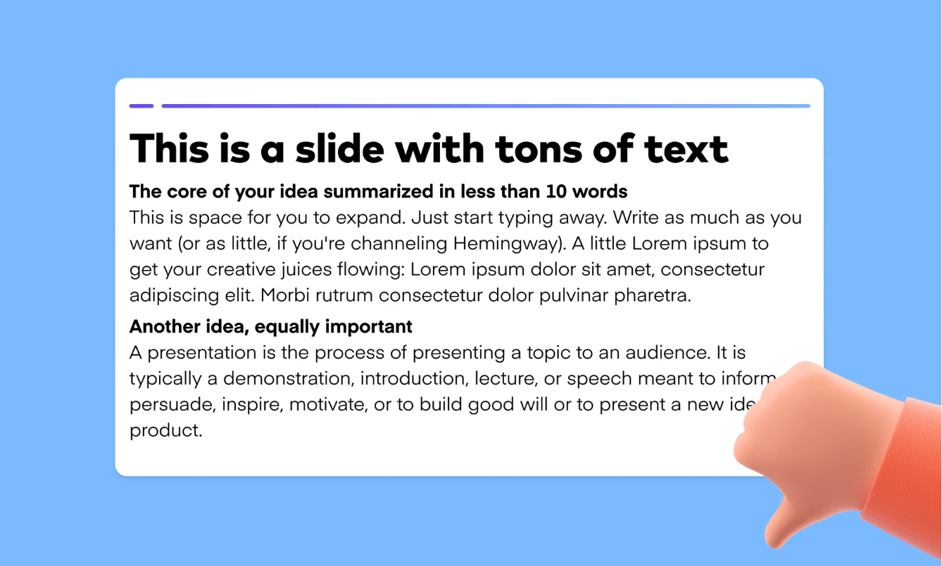
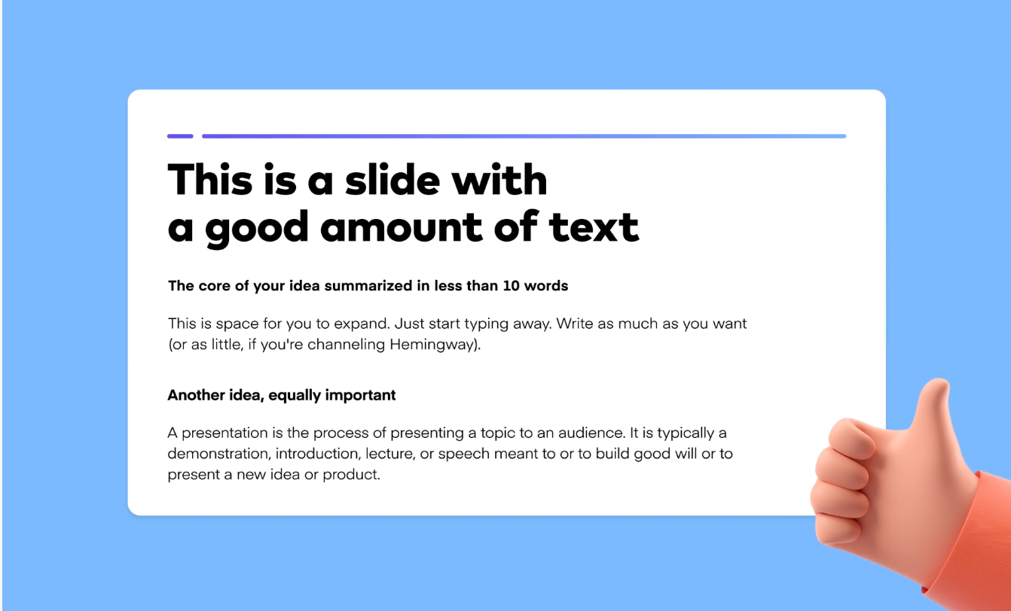

Slide 56
Tips for designing readable presentations
Tip 3: Pay attention to height
Typefaces with higher x-heights are much easier to read, especially at smaller sizes.
Tip 4: Proper line-height is also important
Too tight makes it hard to read/claustrophobic. Too loose makes it feel like the paragraph is no longer a cohesive unit.

Slide 57
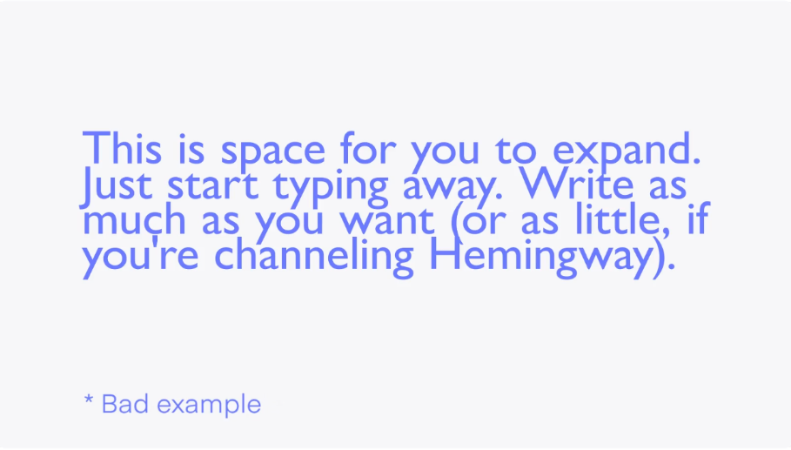
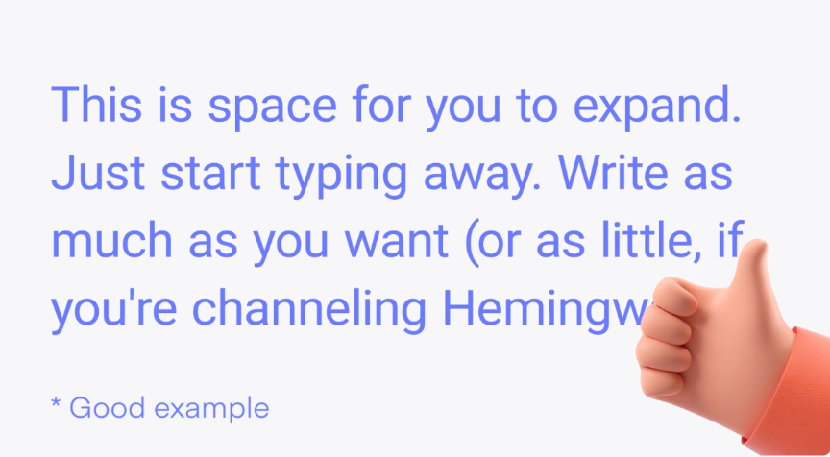

Slide 58
Remember:
Consider various viewing scenarios for your presentation.
For internal presentations, focus on layout and structure as they serve as nonverbal, effective communication.
For screen-based presentations, focus with a "what you see is what you get" approach.
For conference presentations, think about readability from a distance and contrast for clarity.
Notes:
Design decisions should be tailored to the specific medium, whether it's a big screen, mobile device, or print.

Slide 59
Presentation
Presenting information effectively in pitch decks involves the skillful organization and communication of key ideas, data, and content through a combination of text, visuals, and design to engage and persuade the audience, typically in a concise and compelling manner.
The goal is to convey the essence of a business proposal or idea clearly and convincingly, often with the aim of securing investment, partnership, or support.

Slide 60
Tips for presenting information effectively
Tip 1: Use the rule of 3's when organizing information on a slide
You can easily turn a cramped slide of text into a well-organized visual simply by breaking apart the information into three main points.

Slide 61
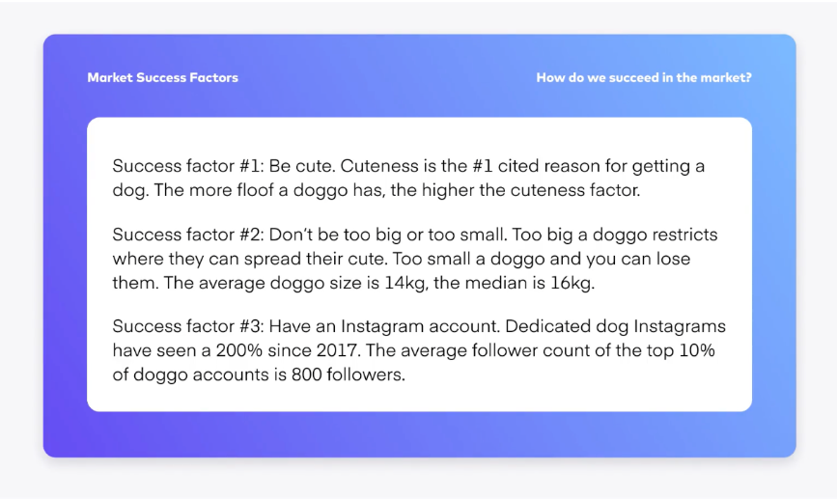
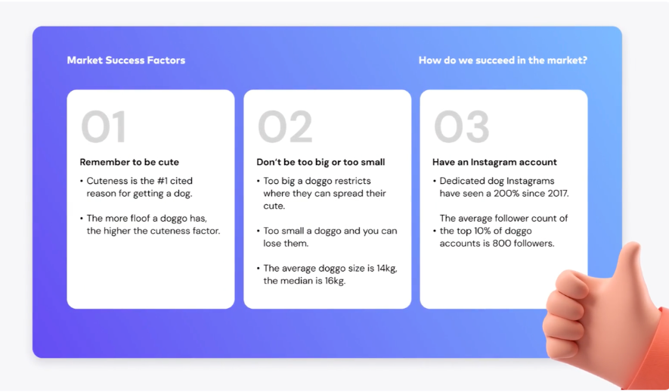

Slide 62
Tips for presenting information effectively
Tip 2: Use emphasis and hierarchy for the most important points
Visually highlight points you definitely don’t want your viewers to miss – by enlarging the font size, making it a different color, or bolding it.

Slide 63
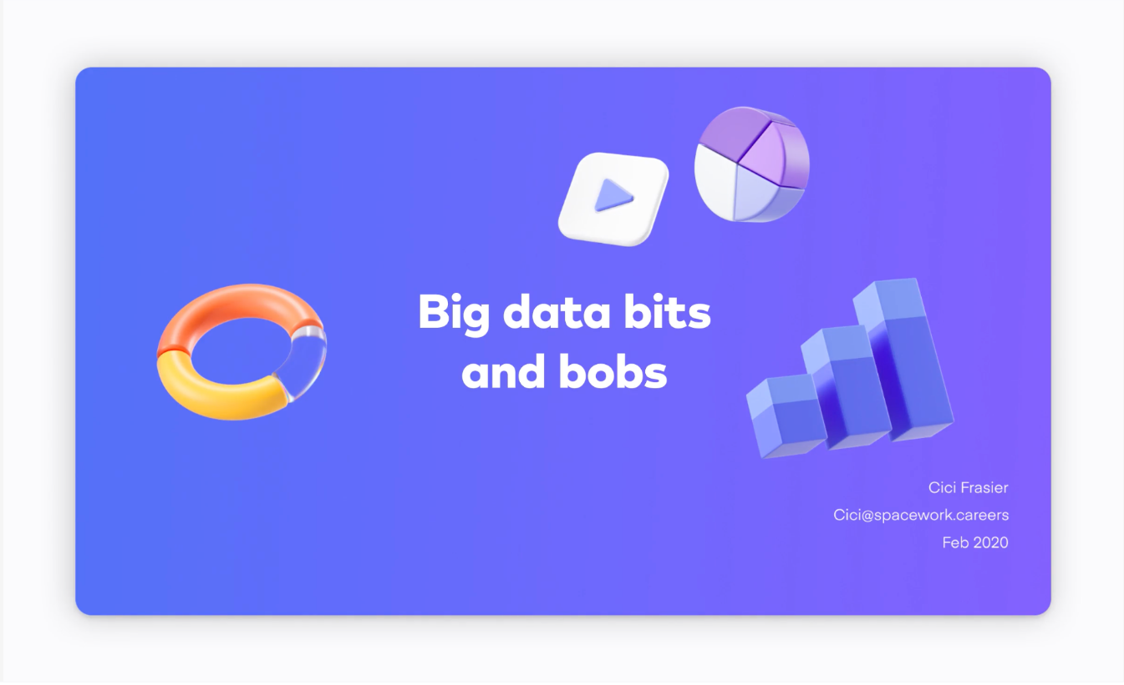
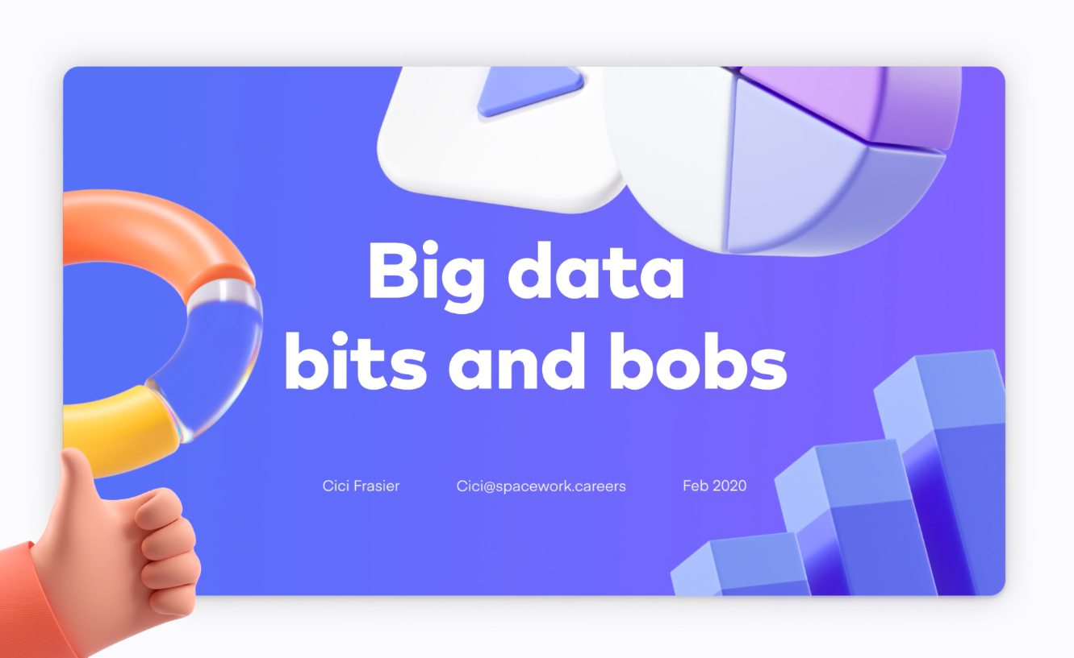

Slide 64
Tips for presenting information effectively
Tip 3: Don’t add extra visuals just because
Visuals should support, not distract from, your point. Too many visuals causes a slide to look cluttered.

Slide 65
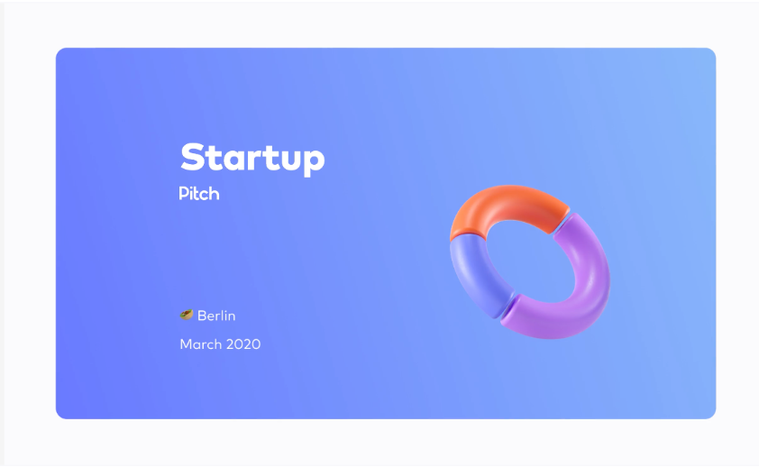
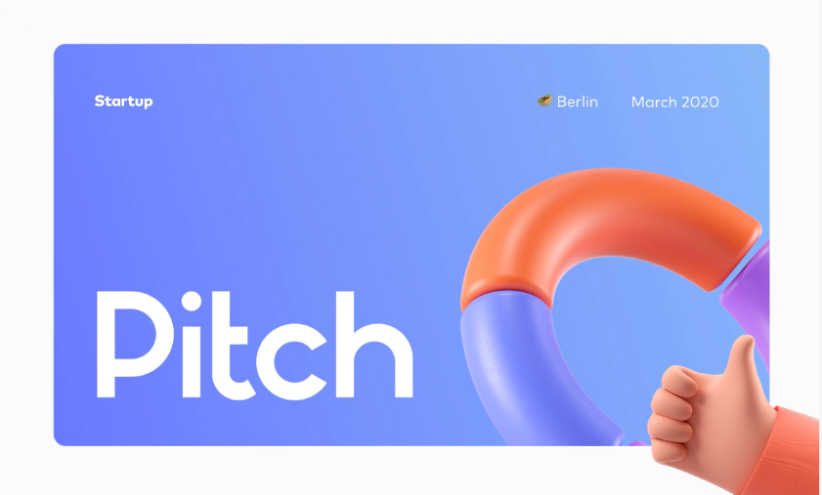

Slide 66
Consistency
A visually consistent presentation is one in which the design elements, including backgrounds, fonts, colors, images, and layout, are uniform and cohesive across all slides. This consistency enhances the overall visual appeal of the presentation and helps create a professional and polished look.
It ensures that the audience perceives the content as a unified and well-organized whole, making it easier to understand and engage with the material.

Slide 67
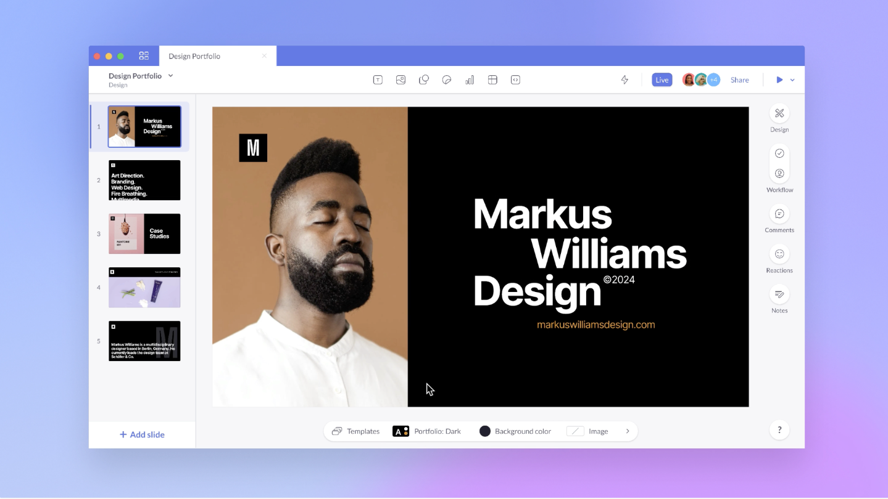

Slide 68
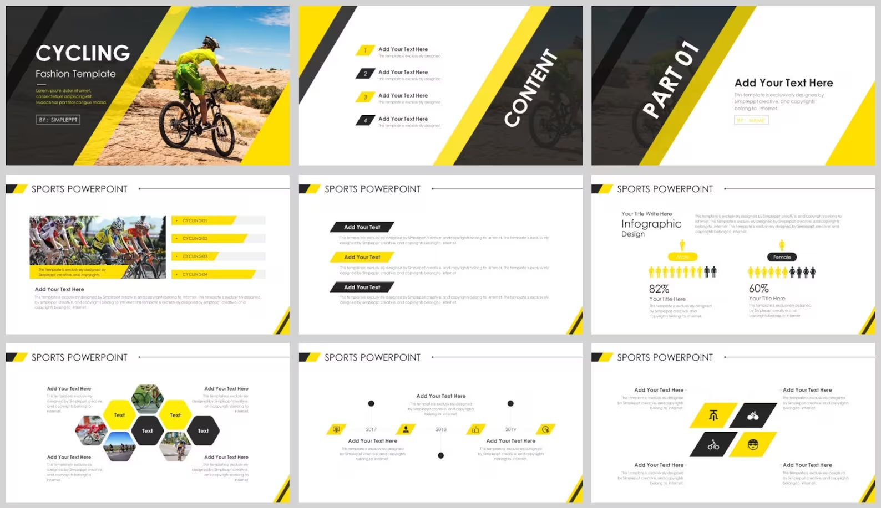

Slide 69
Context
Considering the context in a pitch presentation means taking into account the specific circumstances, audience, objectives, and industry norms relevant to the presentation. It involves tailoring the content, design, and messaging to align with the unique needs and expectations of the situation, ensuring that the presentation is both relevant and effective in achieving its intended goals.
Example: If you're designing an Annual Report for a long-established corporate bank, you might not want to use hot pink, but something more professional and serious, like a deep or light blue.

Slide 70


Slide 71


Slide 72
Quick recap:
Good layout and structure will be your best form of nonverbal, effective communication—keep your slides breathable, digestible, and scannable.
Test your presentation in the actual medium it will be viewed from. This will vary from printed out documents to overhead/enlarged screens.
Remember: A nice design is only part of it! Content and presentation are equally as important.
Ask yourself: Is your content easy to scan? Will your audience be able to understand it without having to read over the content over and over again? Will a graph or diagram help?

Slide 73
Free websites for pitch deck templates
www.canva.com
www.slidesgo.com
www.visme.co
www.slidescarnival.com

Slide 74
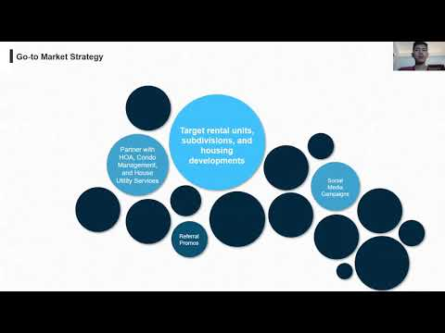

Slide 75
Energy Startup Pitch Examples
Light of Hope
Solar Hope
Solar Sari
Straw Innovations
Circular Solutions
A+ Buildings
Energy Exchange
SmarterMeter
Salin Swap by Salin PH
Recool Technologies
mHycro
SolarWise PH
Pisolar
Hive Energy PH
Shiftech Marine
AuREUS Energetics

Slide 76
Resources
4 tips to design better presentations - https://pitch.com/blog/presentation-design-tips
The Best Startup Pitch Decks - http://bestpitchdecks.com/
8 of the Best Pitch Decks that We’ve Ever Seen - https://www.thinklions.com/blog/the-best-pitch-decks-weve-ever-seen/
30 Legendary Pitch Decks and What You Can Learn from Them -https://piktochart.com/blog/startup-pitch-decks-what-you-can-learn/
50 Best Pitch Deck Examples from 2018 that Got the Investors Talking (At 500 Startups and Y Combinator) - https://www.konsus.com/blog/35-best-pitch-deck-examples-2017

Slide 77
Resources
Demo Day 2018 hosted by Google - https://www.youtube.com/watch?v=ZeNkqfqynbg
The Art of the Pitch- https://www.slideshare.net/saren/the-art-of-the-pitch-44283008/40-The_Art_of_the_Pitch
Startup Science Universal Pitch Deck - http://startupscience.com/universal-pitch-deck/
10-Slide You Need in your Pitch -https://guykawasaki.com/the-only-10-slides-you-need-in-your-pitch/
How to raise a seed round - https://blog.ycombinator.com/how-to-raise-a-seed-round/
What is a pitch deck? - https://pitchdeck.improvepresentation.com/what-is-a-pitch-deck

Slide 78
QUESTIONS?

Slide 79
Part 2 - Mock Pitching

Slide 80
Mock Pitching Session Schedule
Monday, November 13, 2023
6:30 PM - 7:00 PM | BamBreeze | NextEvo Energy
7:00 PM - 7:30 PM | Nano-Teck Solutions | Aluminium Base Peltier Module Solar Panel
7:30 PM - 8:00 PM | Oxypipe Int'l | Agweys
Tuesday, November 14, 2023
6:30 PM - 7:00 PM | SOLARx | DroidOutlet Solutions | Hyfoam
7:00 PM - 7:30 PM | GRaMmers | Green Minds | Solar Island
7:30 PM - 8:00 PM | Project SPARC | RainWatter | Techium
Wednesday, November 15, 2023
6:30 PM - 7:00 PM | SPARGO | e-Gen Tech
7:00 PM - 7:30 PM | Phaethon
7:30 PM - 8:00 PM | SISIG
Thursday, November 16, 2023
6:30 PM - 7:00 PM | SustainaSense

Slide 81
Wrap up

Slide 82
Reminders
Please accomplish your Zen Statement by tomorrow, November 11, 2023.
Submit your 1-min Introduction Videos to philippines@newenergynexus.com and cc dayther.manubag@newenergynexus.com by 11:59 tonight.
Note: We will be sharing your Introduction Video on our Facebook Page, so please share your video as well. The video with the highest number of likes, shares, and views will be awarded the People’s Choice Award.
Submission of final pitch decks will be on November 20, 2023.

Slide 83
Reminders
4. Student teams – send your endorsement letter by November 17 (Friday).
Faculty adviser
Professor
College dean
Student Affairs Chair
5. Disbursement plan
6. Trademark Awareness for Students and Entrepreneurs by AIPO (Nov 16)
Register here: https://www.ateneo.edu/events/2023/11/16/trademark-awareness-students-entrepreneurs

Slide 84
Ready, Spark, Charge:
Hacking the Future of Energy
Perfecting Your Pitch: From Idea to Impactful Presentation
November 10, 2023 | 5:00 PM - 7:00 PM

Slide 85
For inquiries, send an email to:
philippines@newenergynexus.com

